Slide 1
CS35L Software Construction Laboratory
Lab 1 : Nandan Parikh
Week 1; Lecture 2

Slide 2
vi editor
Open a file- vi <filename> or vim <filename>
Close a file- :q
Save a file- :w
Save and close a file- :wq
Modes:
Normal: Enter commands
Insert: Insert text
Visual: Like normal, but you can highlight
Replace: Like insert, but you replace characters as you type
Recording: Record a sequence of key sequences

Slide 3
Emacs editor
“The customizable, extensible, self documenting display editor”
Customizable (no programming)
Users can customize font, colors, etc
Extensible (programming required)
Run Lisp scripts to define new commands
Self-documenting
C-h r (manual) and C-h t (tutorial)
https://www.gnu.org/software/emacs/refcards/pdf/refcard.pdf
http://bit.ly/2CQy3H8 (some basic commands)
http://stanford.io/2CTWNyl

Slide 4
Getting started with emacs
emacs already installed in linux servers
Type emacs to enter into the editor
Emacs has both GUI and CLI
All emacs commands start with ‘C’ or ‘M’
‘C’ = ctrl; ‘M’ = alt (windows)/ option (Mac)
Start emacs
emacs <filename>
Exit emacs
C-x C-c

Slide 5
Basic emacs editing
Insert text by simply typing it
Undo by typing C-x u
Save changes by typing C-x C-s
Copy, cut, paste
C-space (starts selecting region)
M-w (copy a region)
C-w (cuts a region)
C-k (kill a line)
C-y (yank/paste)

Slide 6
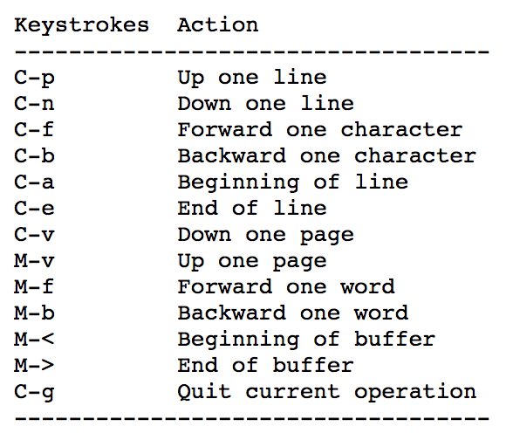
Moving around

Slide 7
More emacs commands
Search – C-s
Replace – M-%
Accessing menu – F10
Switch buffer – C-x b
Switch current window – C-x o
Kill the current window – C-x 0 (zero)
Help – C-h

Slide 8
Directory edit (dired) (C-x d)
Creates an Emacs buffer containing list of directory contents
Allows you to operate on files
Allows you to navigate filesystem
+ - new directory, C-x C-f new file in directory, g - refresh dired buffer
! - run shell command
https://www.gnu.org/software/emacs/refcards/pdf/dired-ref.pdf

Slide 9
Other features
Emacs as lisp interpreter
Use scratch buffer
type (random) or (+ 1 2) or (setq x 2) then C-j
M-: and an expression to evaluate, e.g. ( * 1 2 3)
Run shell command - M-!

Slide 10
Assignment 1: Hints
Hints for first 10 questions:
man man
which
find
Readlink
--version
man chmod
man find
find
ls/sort
localedef
11-15. Use help (C-h) command of emacs

